Slide 1
Social Mobility
Perach Hen Elkayam

Slide 2
Introduction
There is problem of a “Glass Ceiling” for certain subgroups in the society.
In order to suggest a possible solution, I analyzed the data from a 2018 survey by the Central Bureau of Statistics.
National / Military Service is a good predictor for high socioeconomic status, it might suggest a possible solution.

Slide 3
Introduction
Social Mobility: movement of individuals, families, households or other categories of people within or between social strata in society.
Interesting Questions:
1. Can we predict future Socioeconomic status?
2. Can we characterize similar groups by variables of socioeconomic status?
3. Can we identify variables that influence social mobility?

Slide 4
Data Description
X
Age: 30
y
Age: 45-54
Gender
Birth Place (and parents birthplace)
Age moved to independent residence
Age of first marriage
Age of first child
Ethnicity
Mother Education
Father Education
Whether did Military / National Service or not
Mother work status at age 15
Father work status at age 15
How crowded the living place is
How many cars does the participant own
Level of education
Income
Number of apartments
Frequency of using the internet
Frequency of interacting with friends
Satisfaction from family relationships
Satisfaction from the living area
Satisfaction from health condition
Satisfied with life
Satisfied with economic status
Special groups

Slide 5
Creating the socioeconomic outcome
y
Centering, scaling, calculating the mean for each participant and making the variable binary
y
How crowded the living place is
How many cars does the participant own
Level of education
Income
Number of apartments
Frequency of using the internet
Frequency of interacting with friends
Satisfaction from family relationships
Satisfaction from the living area
Satisfaction from health condition
Satisfied with life
Satisfied with economic status
Socioeconomic Status:
High (1) or Low (0).

Slide 6
Train and Test sets
Original Data 1098 Observations
Train 821 Observations
Test
277 Observations

Slide 7
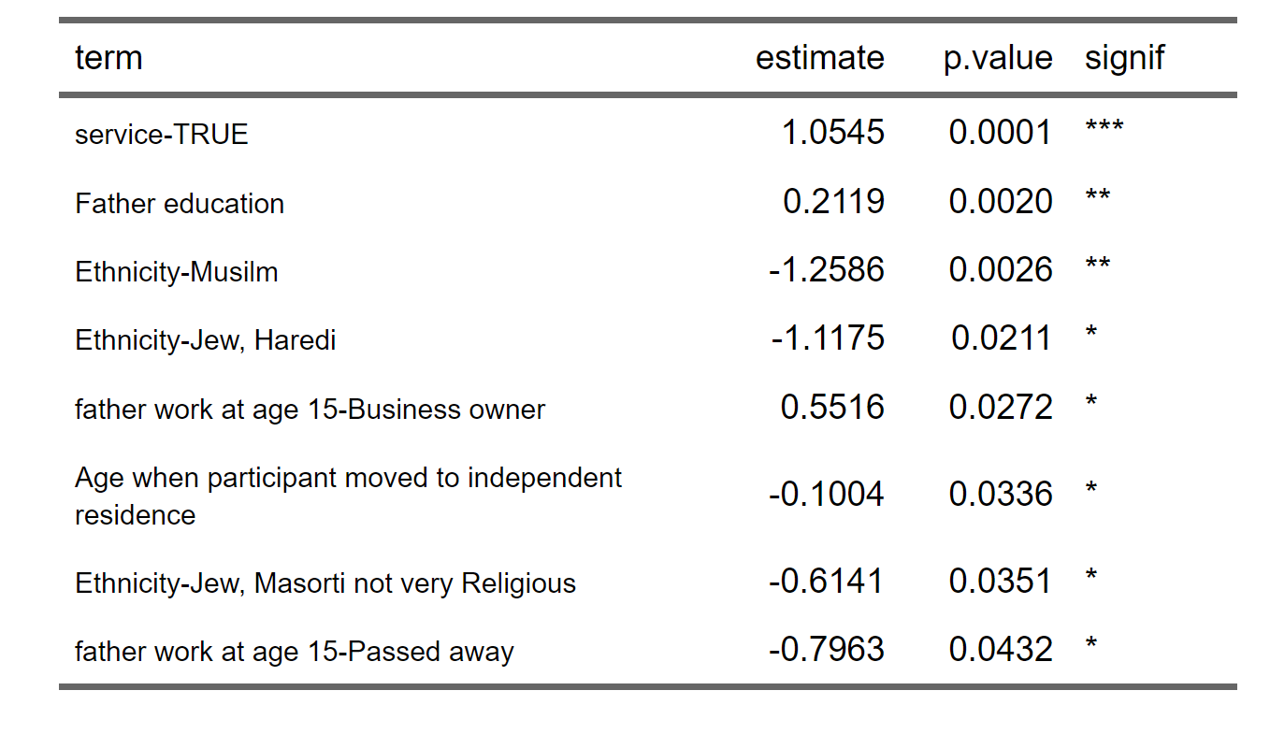
Prediction Models – Logistic Regression
Reference Group:
Secular Jew
Reference Group: Father employee at age 15

Slide 8
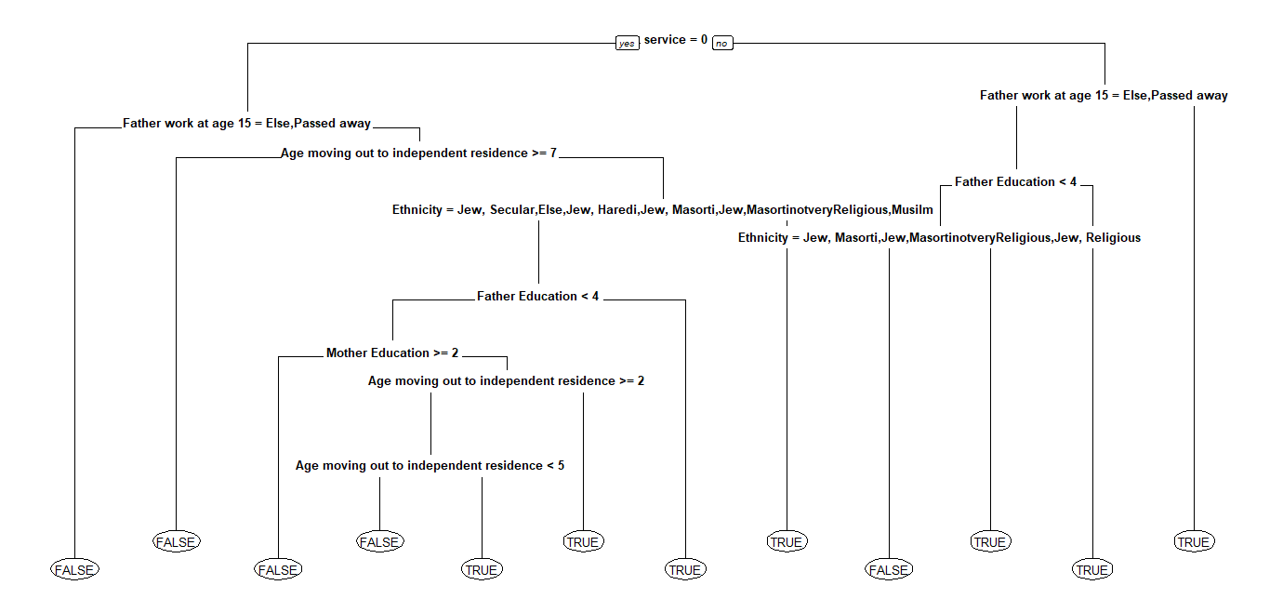
Prediction Models – Decision Tree

Slide 9
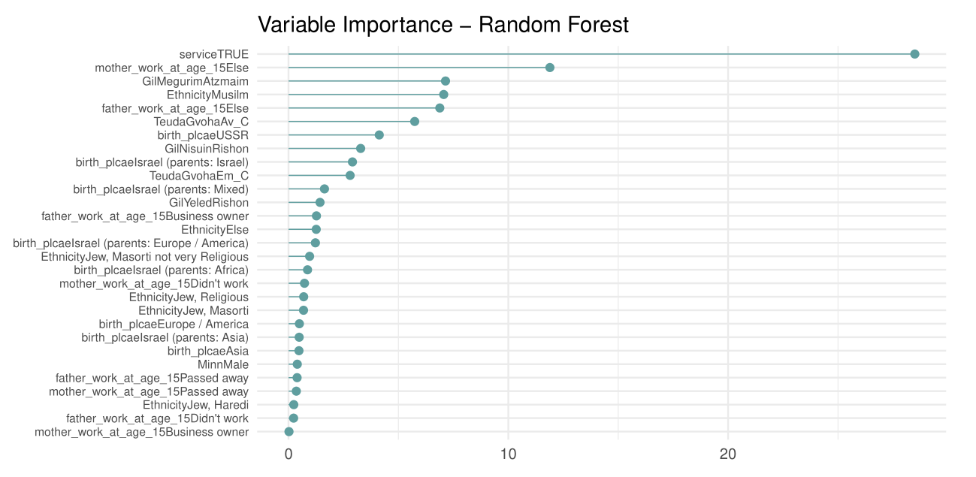
Prediction Models – Random Forest

Slide 10
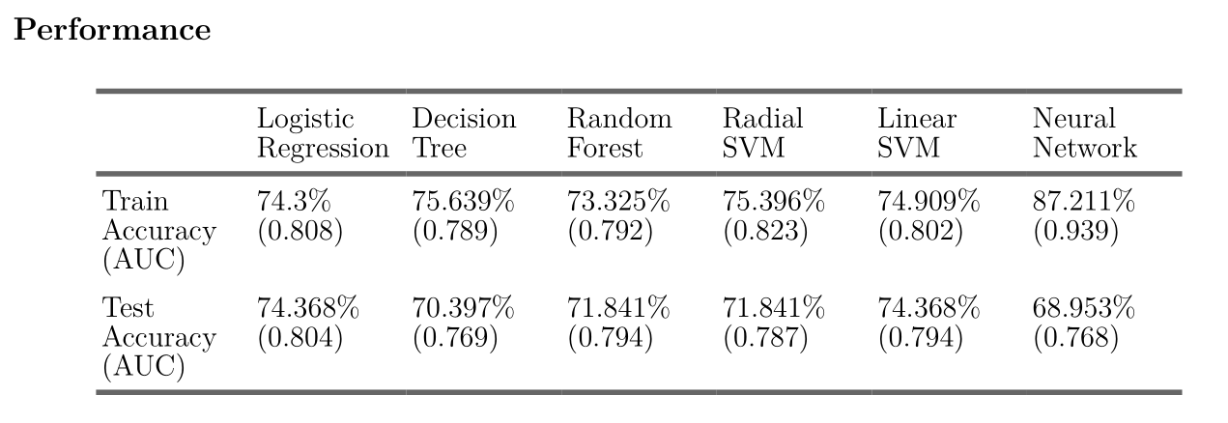
Prediction Models – Results

Slide 11
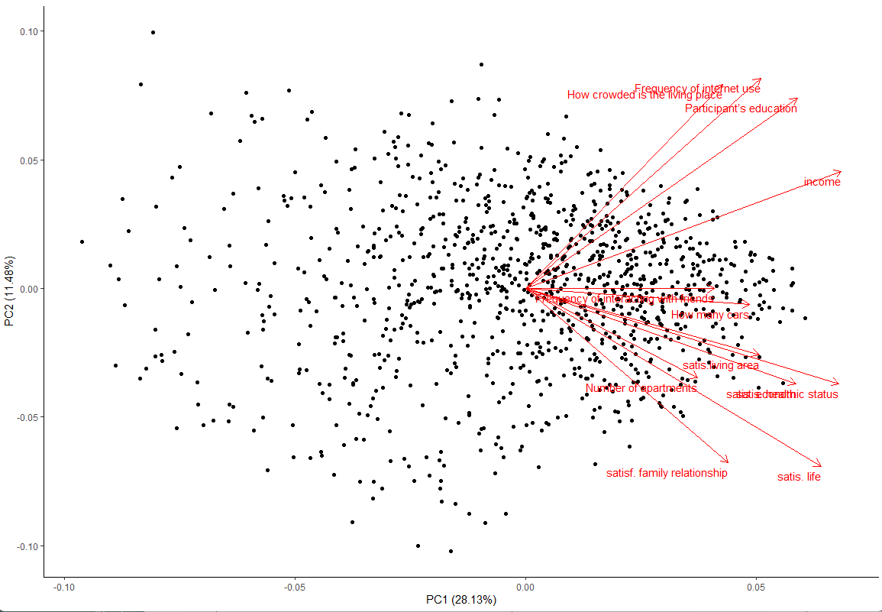
Special groups based on socioeconomic variables: PCA
For the first principal component all the directions are positives, The bigger the value of the first principal component the higher the socioeconomic status (similar to my socioeconomic score).
The second principal component includes different directions: The most influential variables toward the positive direction are the frequency of internet use and how crowded the living place is. Towards the negative direction the most influential variables are how much the participant is satisfied with his life (in general) and with his family relationships.
Data Description

Slide 12
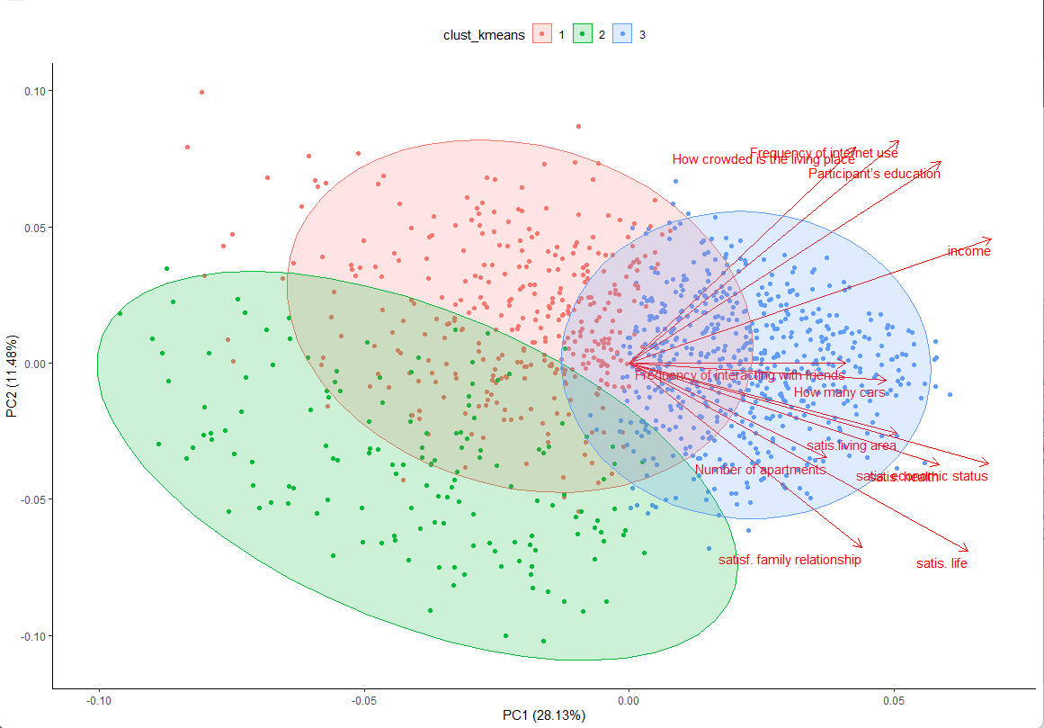
Special groups based on socioeconomic variables: k-means
By using the “Elbow Method” (visualizing the within-group variance for different number of clusters) I decided to find 3 different clusters.
The subgroups can be characterized as:
Cluster 1 (red) - High technological orientation (96% use the internet on daily basis), low satisfaction from
their lives, tend to have values somewhere between the other two clusters.
Cluster 2 (green) - Mostly conservative population (65% Jew Haredi or Muslims), low technological orienta-
tion (90% don’t use the internet), more satisfied with their lives compared to Cluster 1.
Cluster 3 (blue) - High Socioeconomic status in every observable aspect.

Slide 13
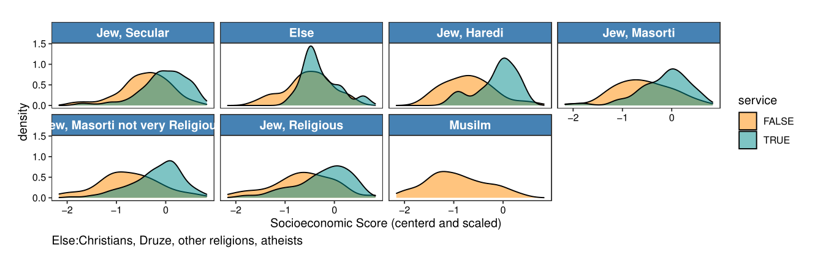
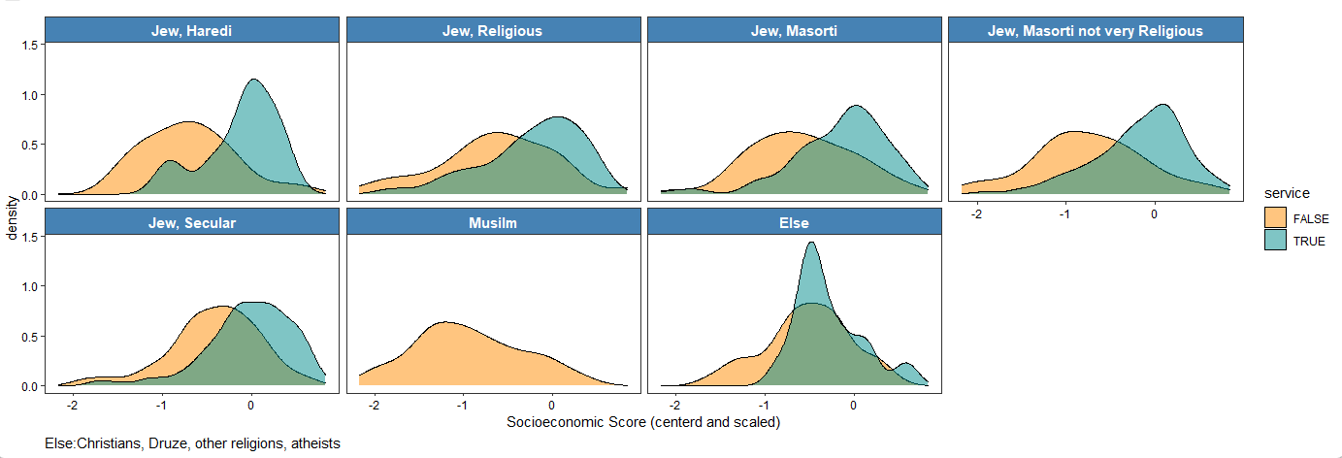
Exploring Subgroups (Possible Inference)
The effect of the service is consistent in all ethnic groups!

Slide 14
Discussion and Conclusion
Taking a part in a military or a national service might make individuals feel as an integral part of the society.
There are different subpopulations as I found in the cluster analysis and perhaps different subgroups should be treated in different ways.
These conclusions seem to be consistent with Raj Chetty work on social mobility in the United States: Two of the five main predictors were segregation and strength of social networks. In the Israeli military service different people from different backgrounds get to know one another and one can see the Israeli army as one big social network.

Slide 15
